Slide 1

27 Nov, 2018
The University of Hong Kong
Second International Summit on Human Genome Editing
Update: Governmental Actions and Advisory Opinions
Regarding Human Genome Editing
Regulatory Actions for Researches Using Genome Editing Technology on Human Embryos in Japan
AKUTSU, Hidenori
Director, Department of Reproductive Medicine,
National Center for Child Health and Development
On behalf of the Science Council of Japan
Notes:
Thank you Jeniffer. Great pleasure to having me here to share current regulatory status in Japan. My background is ob/gynest and then working on stem cell/reprogramming research works. Today, On behalf of Science Council of Japan, and as a member of the expert panel on bioethics of Japan, I will introduce recent regulation actions in Japan for genome editing on human embryos.
自由診療：private practice

Slide 2
Basic policy on using human embryos for research purpose
2004 “Basic Principles concerning the Handling of Human Embryos”
Basic policy on creating human embryos for research purposes
In Japan, creating human embryos for research purpose is not permitted in principle.
It is permitted to use surplus embryos for biomedical research in exceptional cases, but all of the following conditions must be met:
(1) scientific significance in life sciences and medicine, which cannot be obtained other
than through the use of human embryos
(2) the benefits or anticipated benefits are socially appropriate
(3) assurance of safety for human being
(4) safeguards must be put in place to avoid concerns of reducing human beings
as a tool
[Council for Science, Technology and Policy (CSTP) (2004)]
2
Notes:
Regarding the basic policy on using human embryos for research purpose, in the morning session prof. Kodama presented precisely. Basic policy on producing human embryos for research purposes
Creating human embryos for research purpose is not permitted in principle. It is permitted to use surplus embryos for biomedical research in exceptional cases, but all of the following conditions must be met: (1) scientific significance in life sciences and medicine; (2) the benefits or anticipated benefits are socially appropriate; and (3) assurance of safety for human being. Even if these conditions are met, (4) safeguards must be put in place to avoid raising concerns of reducing human beings to tools.

Slide 3
Basic policy on using human embryos for research purpose
Related laws and regulations
Type of research | Status | Related guideline
Creation and use in assisted reproductive technology research. | Possible | Ethical Guidelines for Research on Assisted Reproductive Technology Treatment Producing Human Fertilized Embryos
Use for human embryonic stem cells. | Possible | The Guideline on the Derivation of Human Embryonic Stem Cells
Researches on producing germ cells from Human iPS Cells or Human Tissue Stem Cells, ES cells. | Possible *Prohibiting fertilizing induced germ cells | The Guidelines on the Research on Producing Germ Cells from Human iPS Cells or Human Tissue Stem Cells, The Guidelines on the utilization of human embryonic stem cells
Transfer of human SCNT embryos. | Impossible | The Act on Regulation of Human Cloning Techniques
Handling of human-animal chimeric embryos. | Possible | The Guidelines for Handling of a Specified Embryo (human-animal chimera)
Gene therapy to human embryos. | Impossible | The Guideline for Gene Therapy Clinical Research
3
Notes:
Base on the Basic policy on human embryos for research purpose, they have 7seven guidelines and law, including human ES cells derivation, The Guidelines on the Research on Producing Germ Cells and so on. And now another new guideline will be listed here.

Slide 4

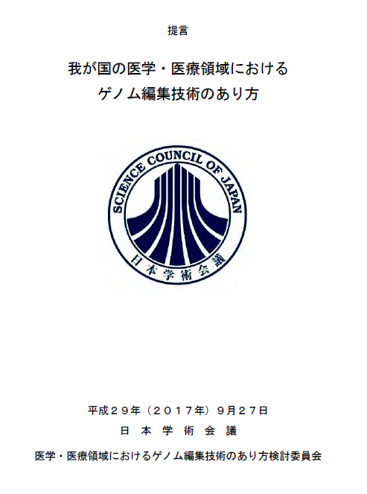
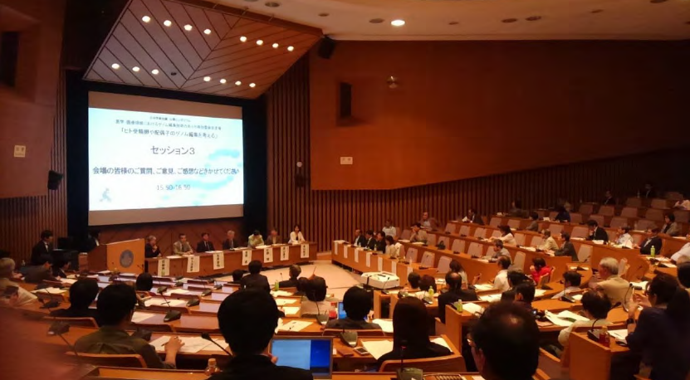
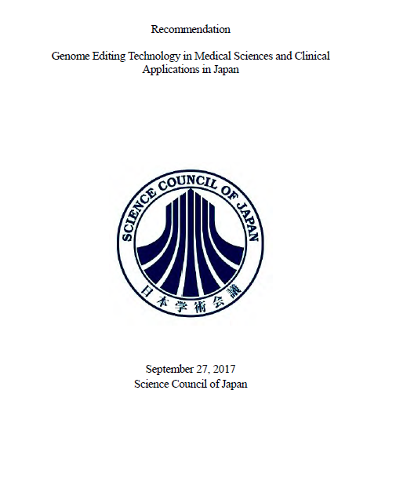

Expert Panel on Bioethics, Council for Science, Technology and Innovation (CSTI) of Japan
“The interim report for research using genome editing technology on human embryos” (Apr, 2016)
Implementing the public comments on the draft guidelines for research using genome editing on human embryos (Nov, 2018)
the Japanese Expert Panel on Bioethics
Science Council of Japan in July 2016 started discussions by a committee of specialists on issues related to medical research and treatment that applies genome editing to fertilized human embryos.
“The Recommendation on Genome Editing Technology in Medical Sciences and Clinical Applications in Japan” (Sep, 2017)
Public symposium on human germline editing (Apr, 2017)
4
Notes:
We have two main working. Government side, The expert panel on Bioethics of Japan has been working on genome editing on human embros based on 2004 Basic principle since 2015. Recently it has just released the draft guidelines for research using genome editing human embryos Nov.
Independently, Science Council of Japan in July 2016 started discussions by a committee of specialists on issues related to medical research and treatment that applies genome editing to fertilized human embryos. Having total 12 meetings and two public engaged symposiums held, and last year the recommendation issed.
The recommendation is covering not only germ line editing also somatic cell’ s plactical applications. Today I take on the comment on germ line editing.

Slide 5
Summary of
the draft guideline/the Recommendation for studies using genome editing technology on human embryos in Japan
5
Notes:
The recommendation and the guideline

Slide 6

1. Clinical Use (germline editing)
Transplantation of genome edited human embryos into human and animals should be prohibited.
6
Notes:
It is not acceptable due to sceintfically, medically, ethically and socially concerns not been cleared yet.
Following issues are remaining,
・Risk of off-target effect and/or mosaic mutation.
・Inability at present to predict the impact of genetic modification on other genes.
・Concerns of the impact across generations.
・Ethically and socially concerns not fully debated in our public. Necessary for careful debate in our greater society.

Slide 7
2. Research purpose
Purpose of studies using human preimplantation embryos
a) Elucidate the function of genes in early development
b) To understand the mechanisms of hereditary diseases
c) Development of new treatments (preventive treatment) for diseases (cancer, etc.)
Basic studies may well contribute to the “understanding of genetic functions of embryo early development and growth (differentiation)”.
・Surplus embryos (not intended for clinical use) must be used.
・The handling period of human embryos must be limited to the early embryo stage, prior to primitive streak formation (not over day 14).
・Human embryos used in research must also be disposed of in a secure manner.
the draft guidelines for research using genome editing on human embryos
7

Slide 8
3. Other comments on the ethical guideline
It cannot be approved that any clinics (germline genome editing) at the present time.
The Panel has left the door open to acceptance of basic research, encouraging debate in the research community and the general public.
The Panel will strive to continue finalization of the report incorporating with related government ministries and agencies.
Ethical guidelines in Japan are similar to “soft law” but have some sanctions: for instance, researchers who violate them are required to repay research funds they received, or may be barred from qualifying for future grants (in a least 5 years).
8
Notes:
Here is other comments on the guideline,
It cannot be approved that any clinics (germline genome editing) at the present time.
The Panel has left the door open to acceptance of basic research, encouraging debate in the research community and the general public.
The Panel will strive to continue finalization (in the year) of the report incorporating with related government ministries and agencies.
Ethical guidelines in Japan are similar to “soft law” but have some sanctions: for instance, researchers who violate them are required to repay research funds they received, or may be barred from qualifying for future grants (in a least 5 years).

Slide 9
Thank you so much for your attention!
Notes:
文部科学省
Ministry of Education、Culture、Sports、Science and Technology
厚労省
Ministry of Health、Labour and Welfare

